Slide 1
“Cyclistic”
Bike-share Company Chicago
Presented by: Matthew R. Ellwood
Last Updated: 29th May 2022
Notes:
This presentation was drawn from the request by the Managers at “Cyclistic” in Chicago. A Bike Share company operating from numerous areas across the city..

Slide 2
Table of contents
“Cyclistic” Bike – Share.
•1. How do annual members and casual riders use ‘Cyclistic’ bikes differently
•2. Descriptions of Analysis completed to answer the question.
•3. Creating answers from the data
•4. Conclusion
•5. Appendix
Notes:
What we are going to view today is firstly, How Annual members of the company and Casual riders use the bikes differently
Next, we will show you what we did to find the answers from the data supplied, and then formulate the conclusions.

Slide 3
How do annual members and casual riders use Cyclistic bikes differently
Using data stored from bike trips between 2019 and 2020
Notes:
How do the members and casual riders use the system differently

Slide 4
Searching the data for any correlation
Notes:
We began by searching through all the data for any correlations

Slide 5
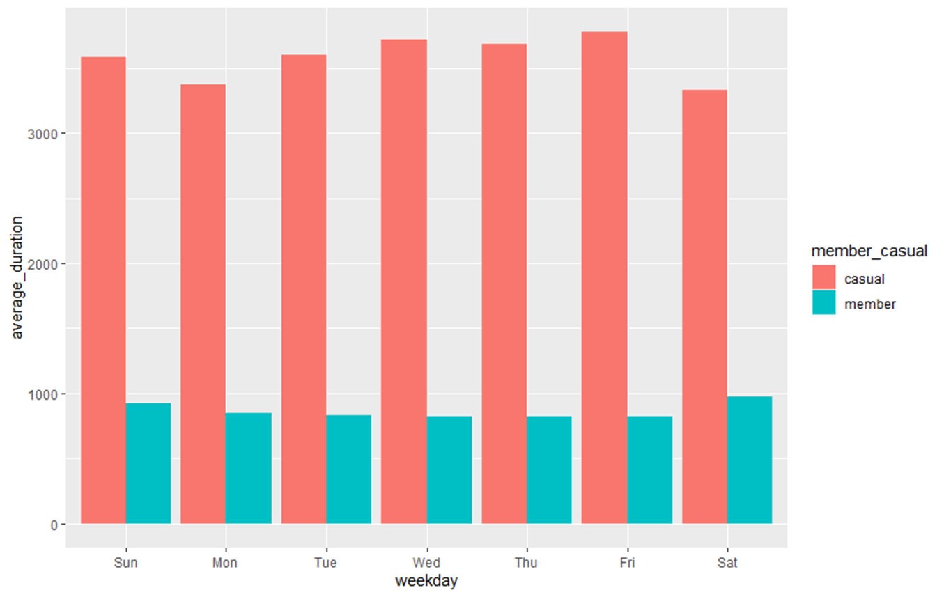
The correlation between the length of time of the rides per weekday, against members and casual riders.
Notes:
This chart shows the difference between the casual riders shown in red, and the members shown in green, against each weekday, and how long each groups rides lasted.
The results show that the casual riders used the bikes for a lot longer trips than the members, across each and every weekday.

Slide 6
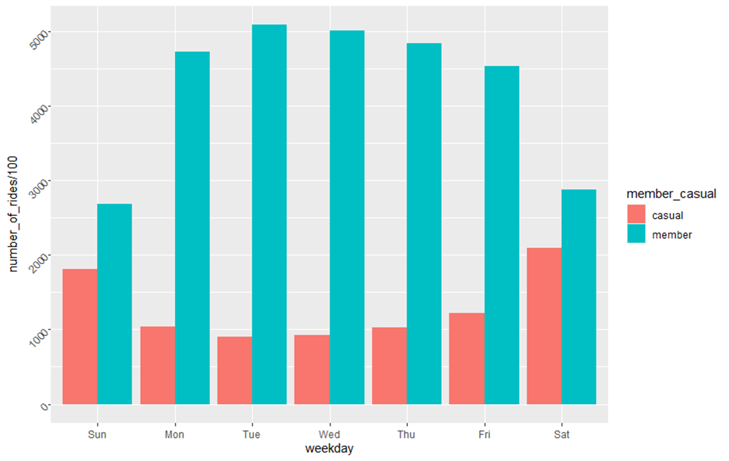
The correlation between members / casual riders against the number rides they each make
Notes:
This chart shows that the NUMBER of separate rides, again grouped by members and casuals across the week.
Showing that the members actually use the bikes for a lot more trips than the casual riders.

